Slide 1
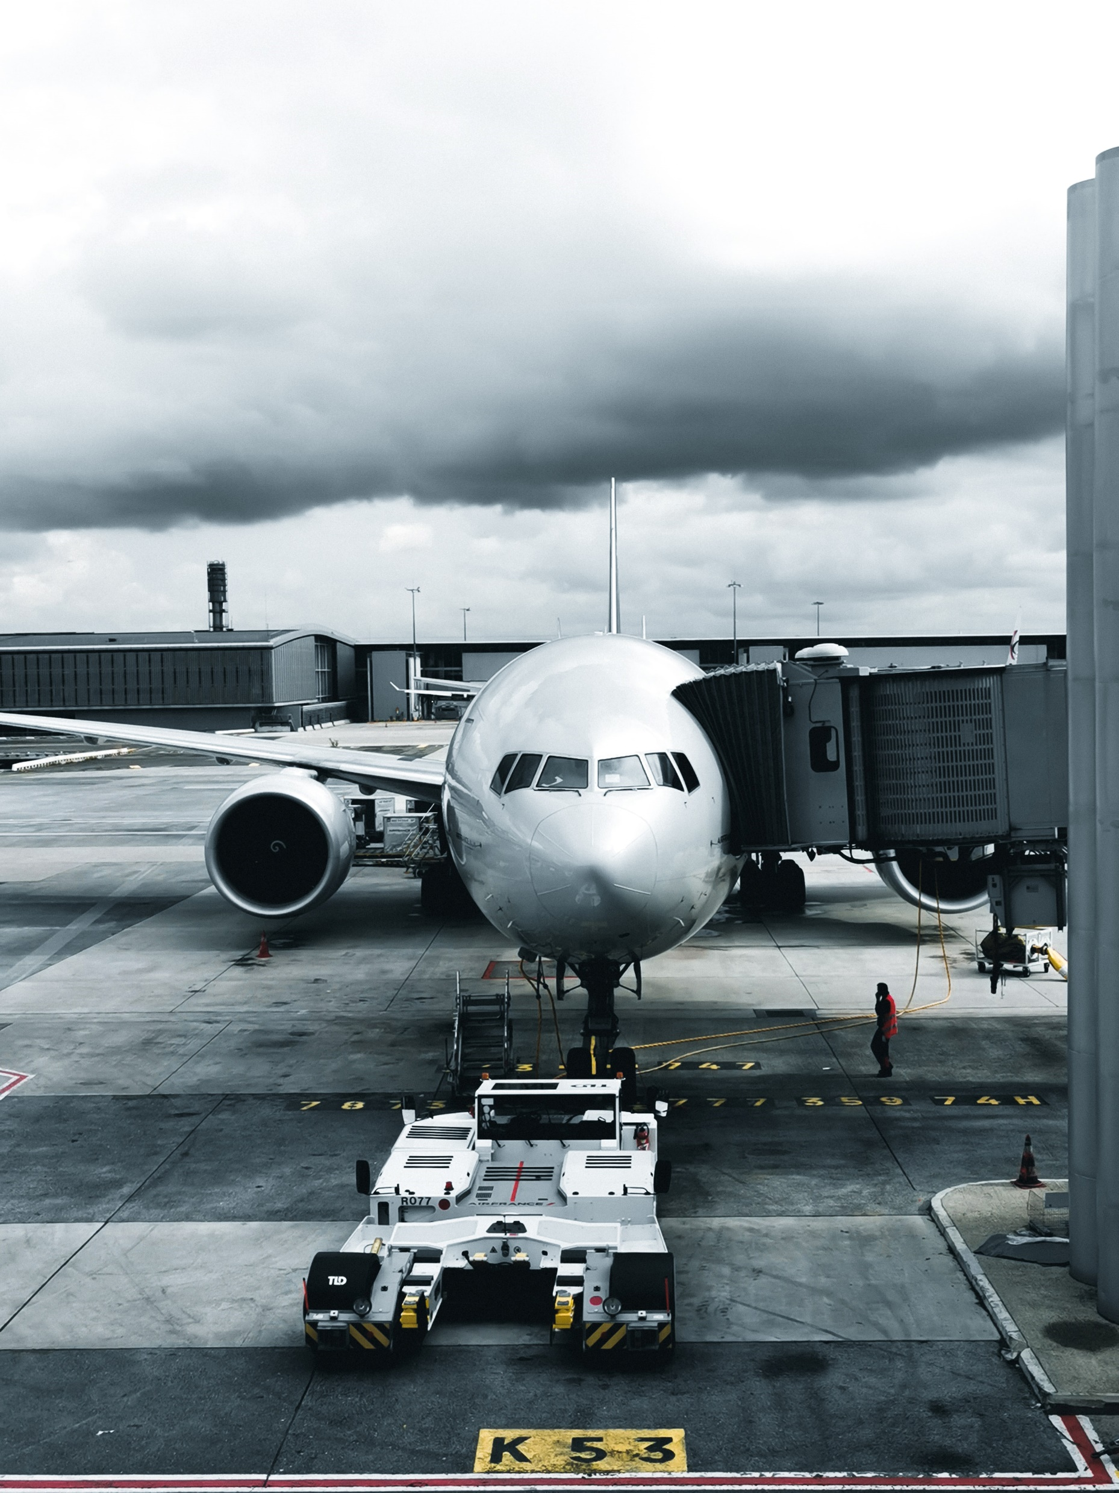
Welcome to FlyAway
(An Airline Booking Portal)

Slide 2
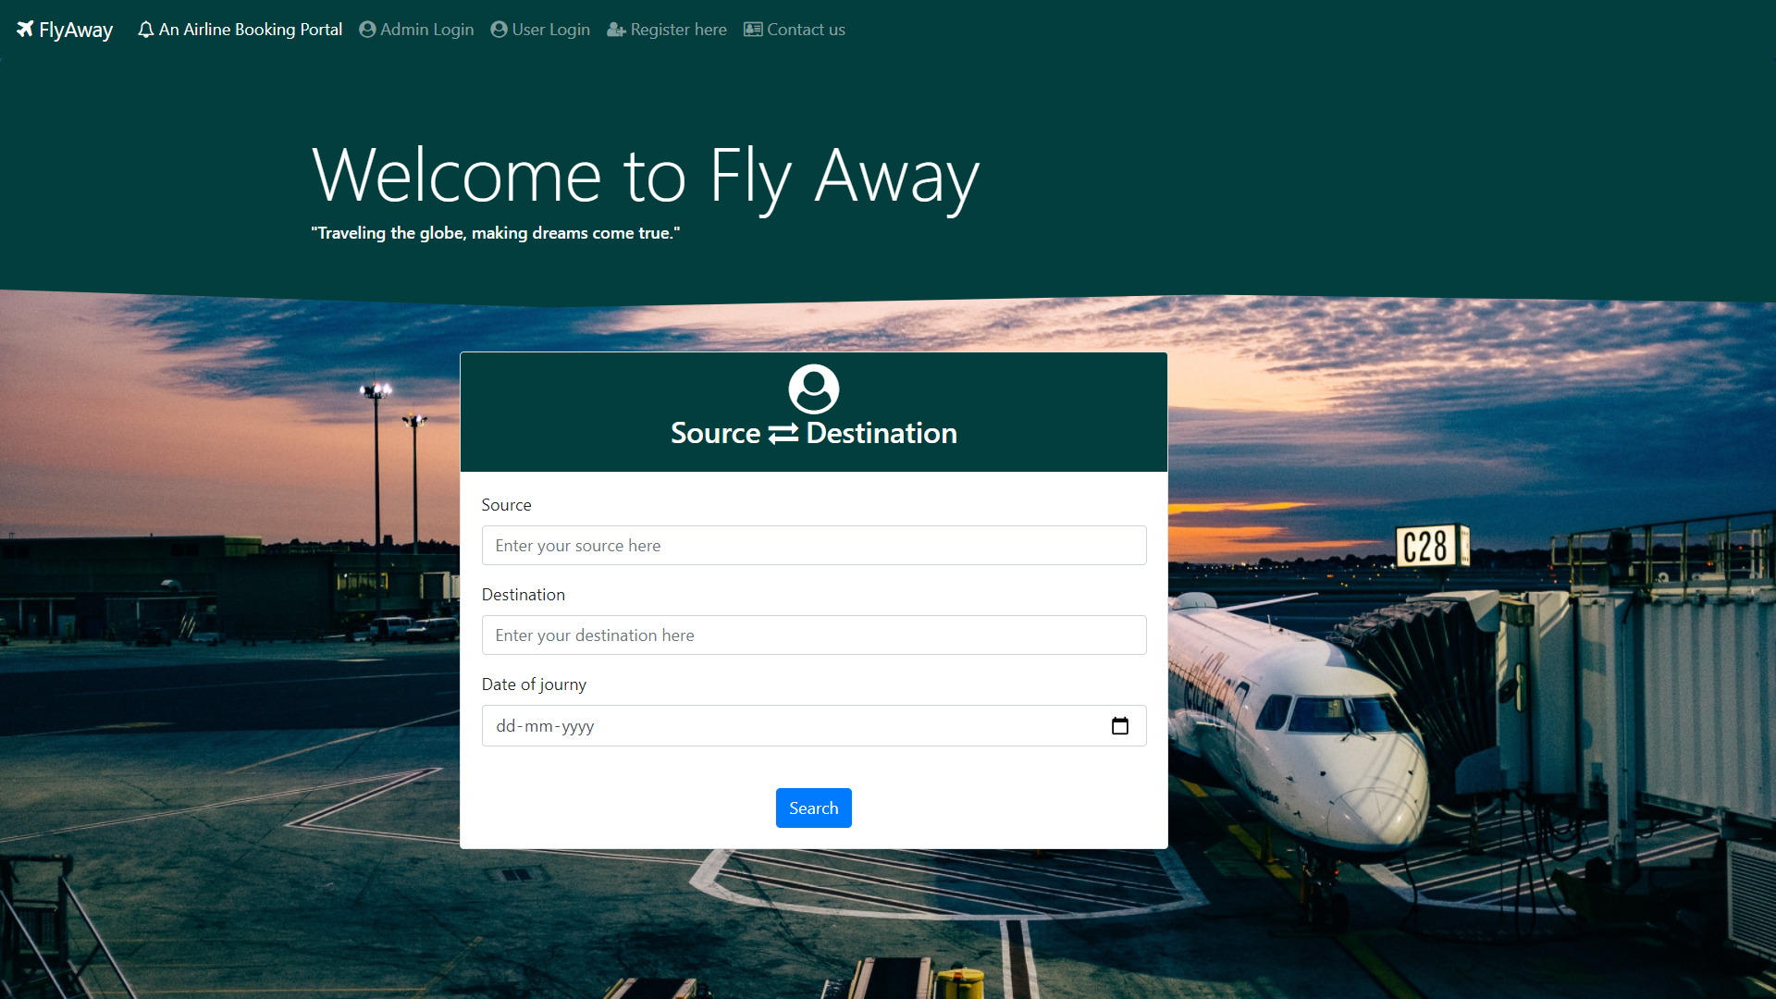
Home Page

Slide 3
Registration Module

Slide 4
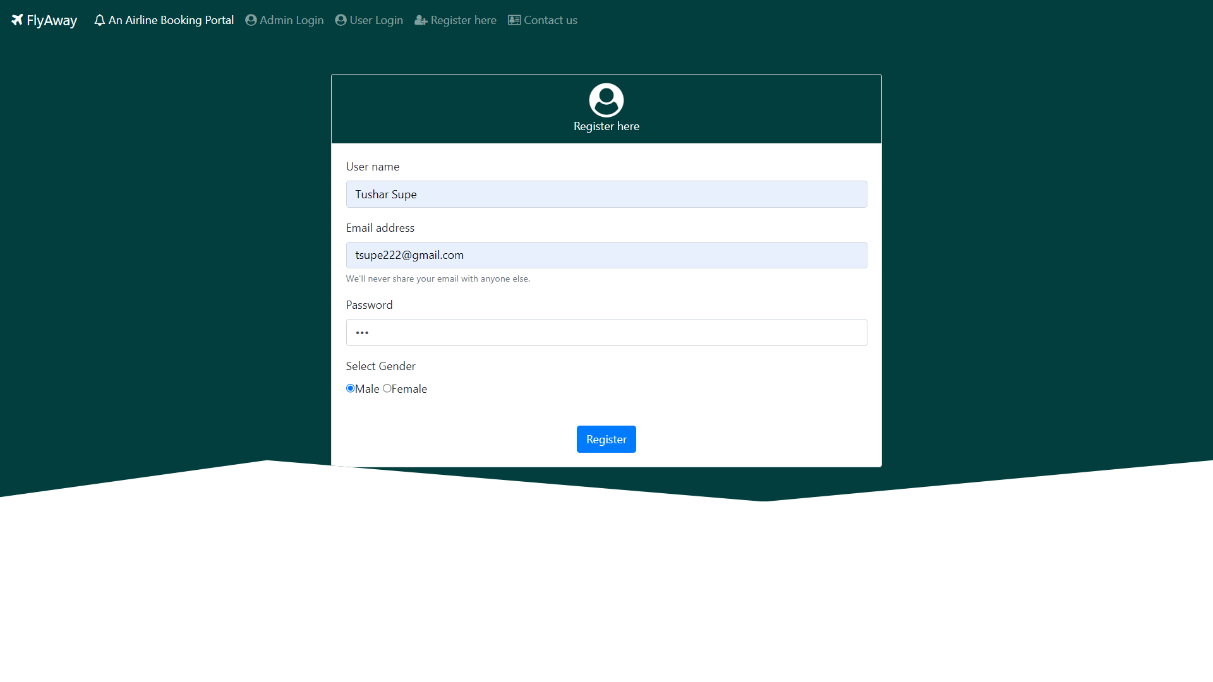
Registration page

Slide 5
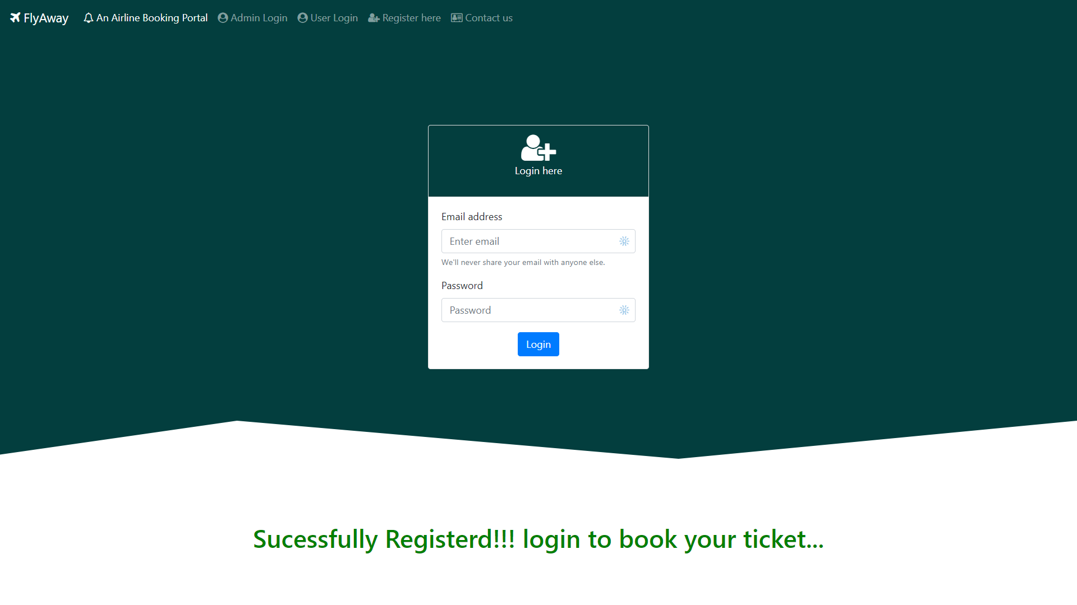
After Registration

Slide 6
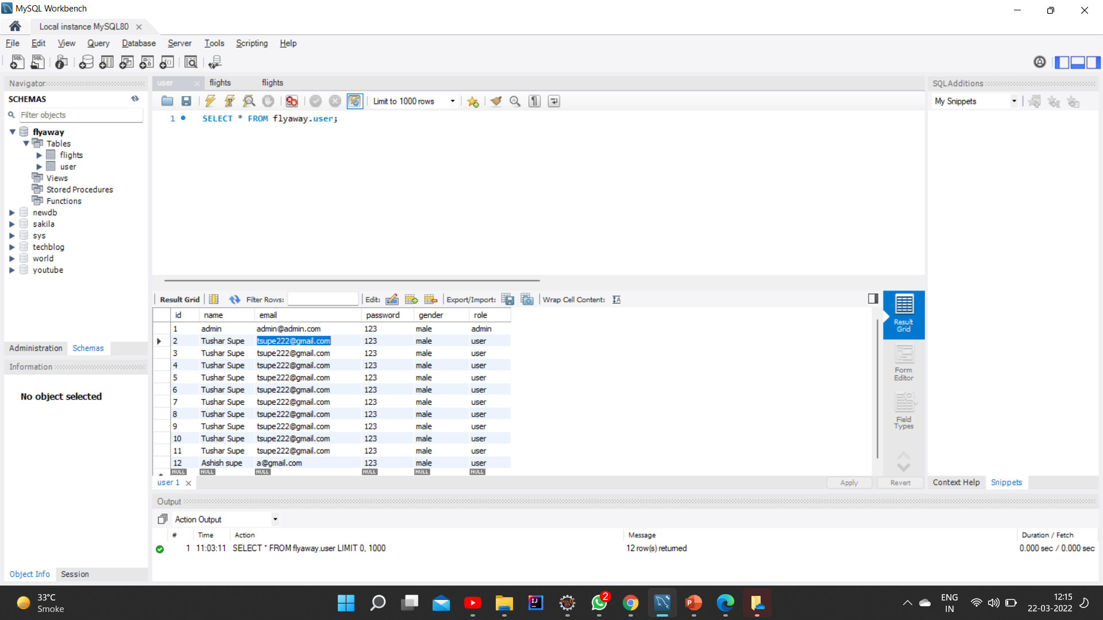
User saved in DB

Slide 7
Login Module

Slide 8

Admin page

Slide 9
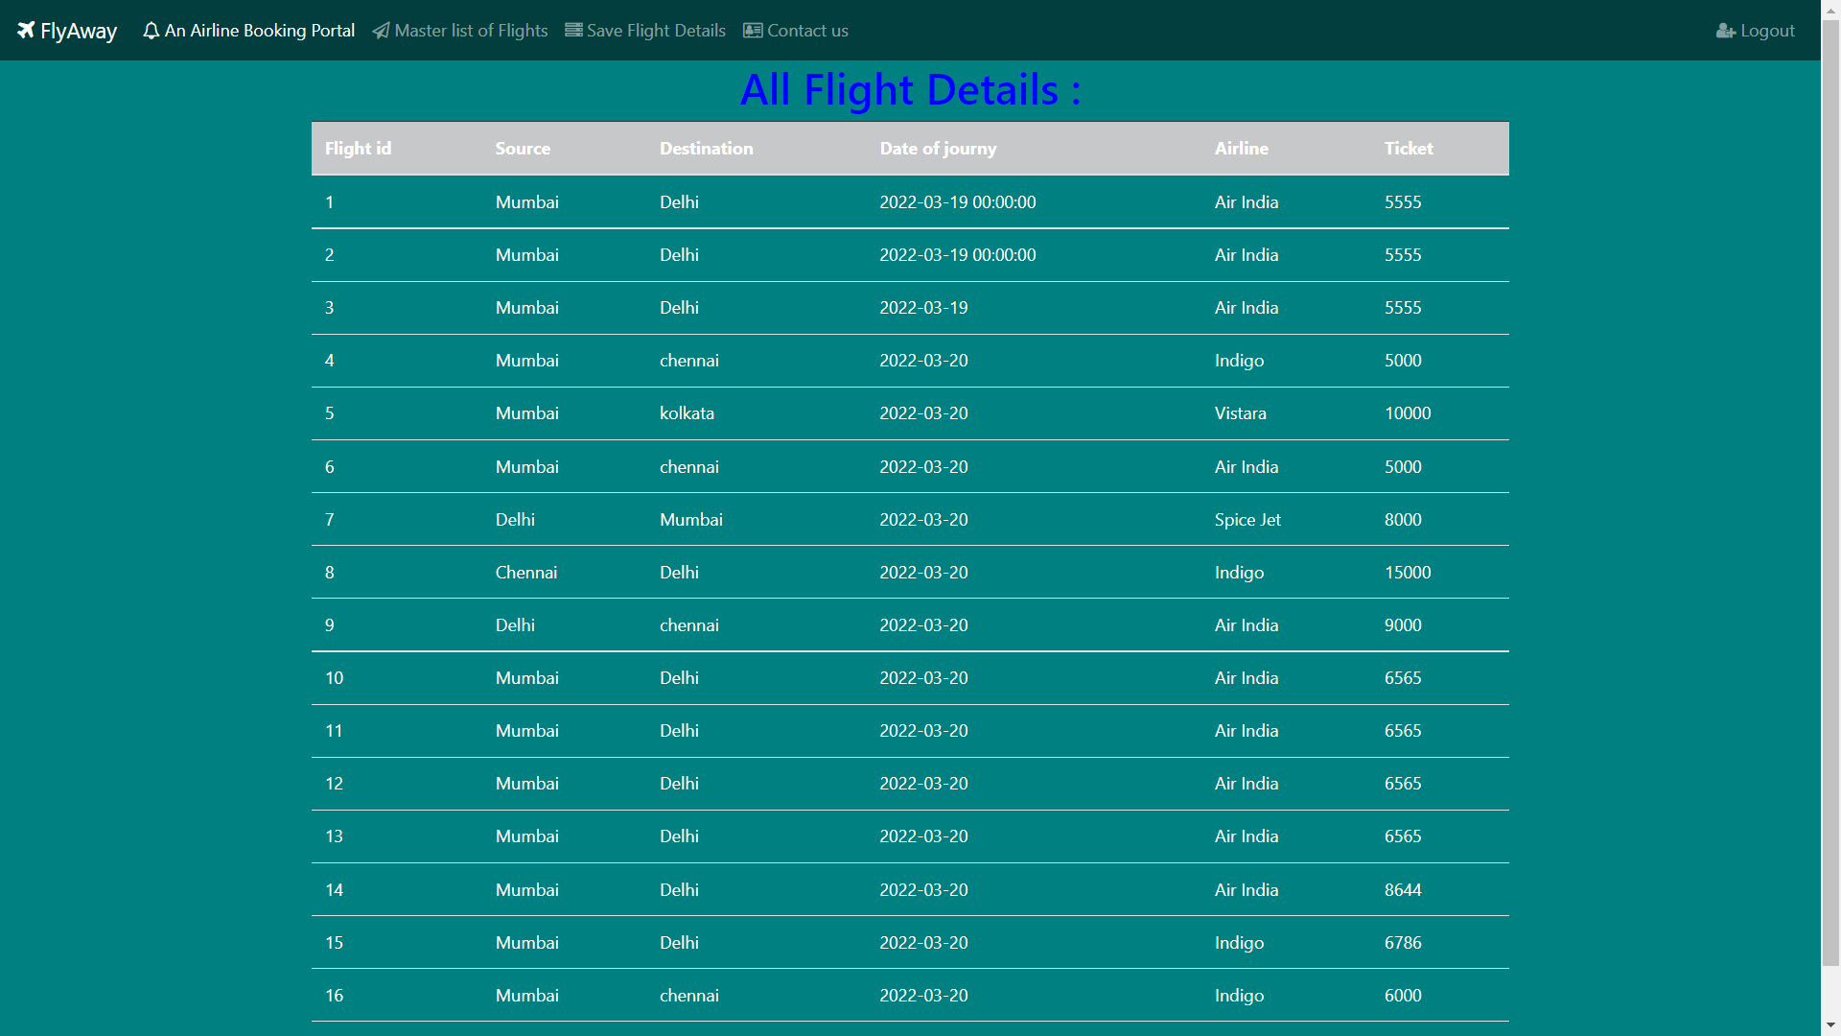
View Master list of flights(ADMIN)

Slide 10
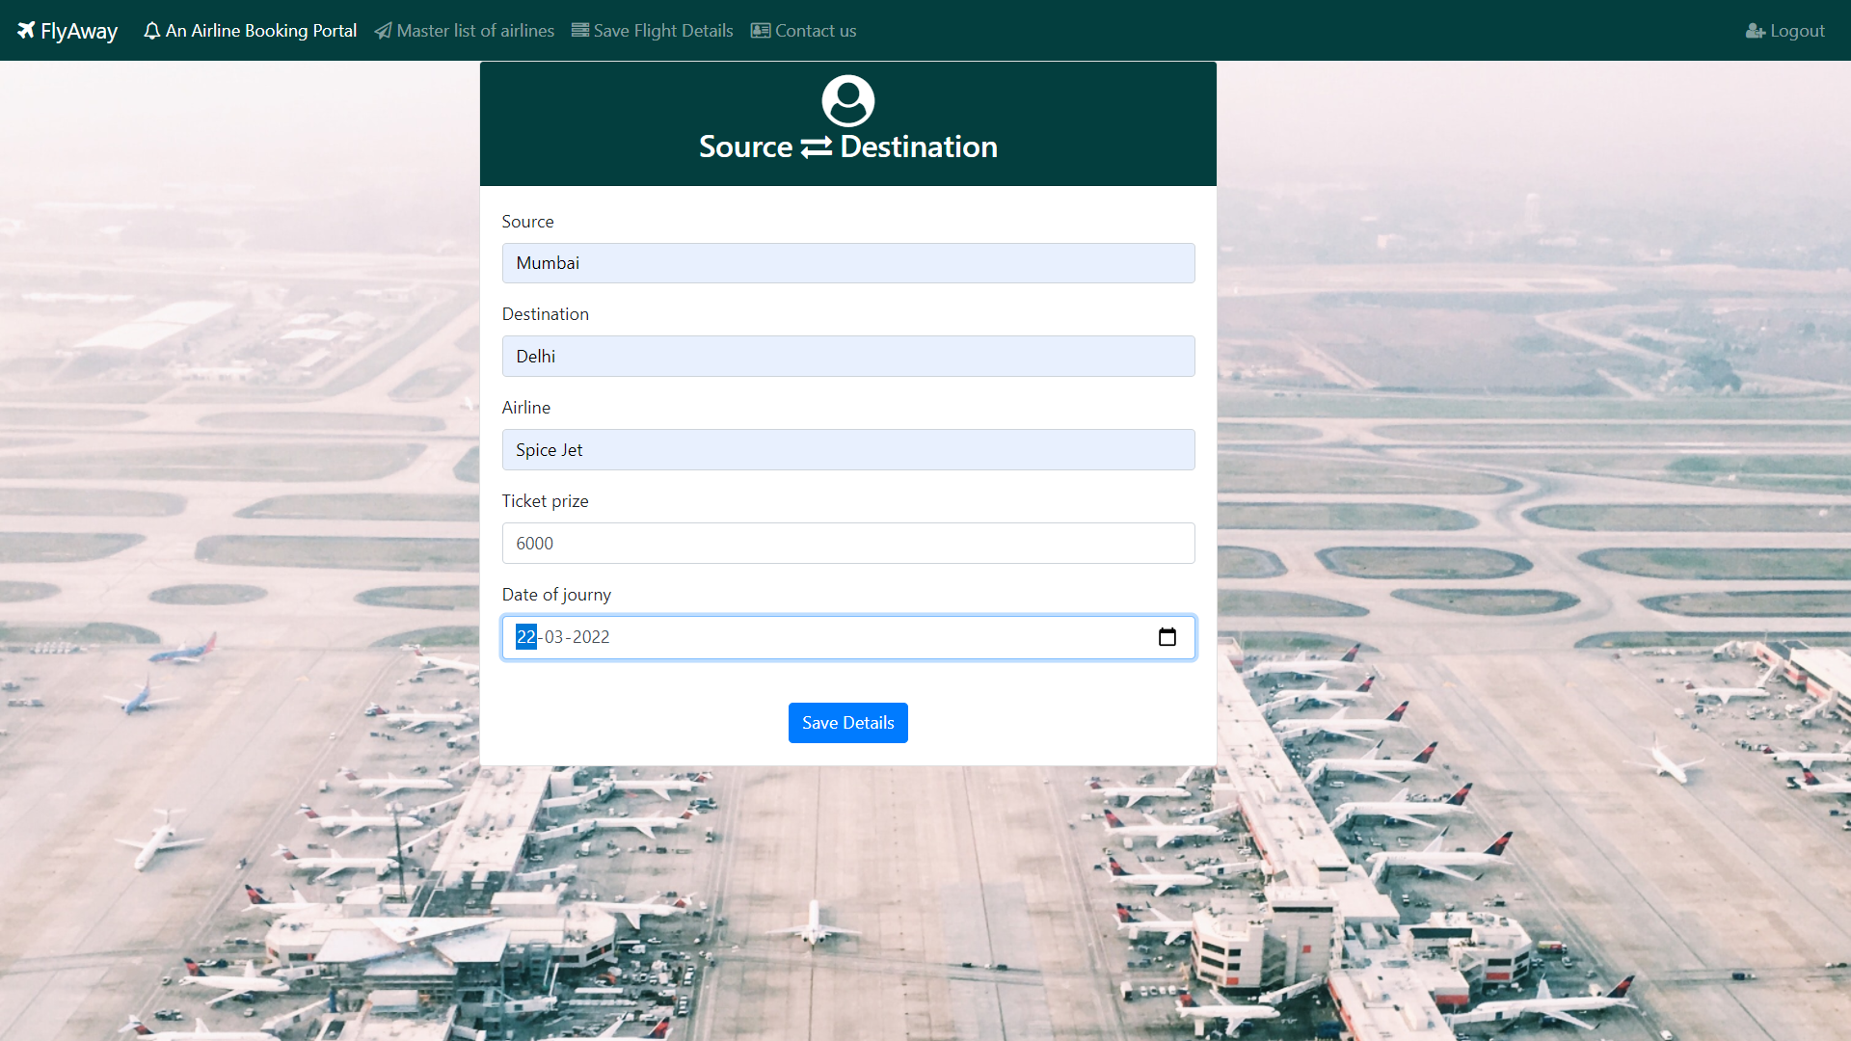
Save flight details(ADMIN)

Slide 11
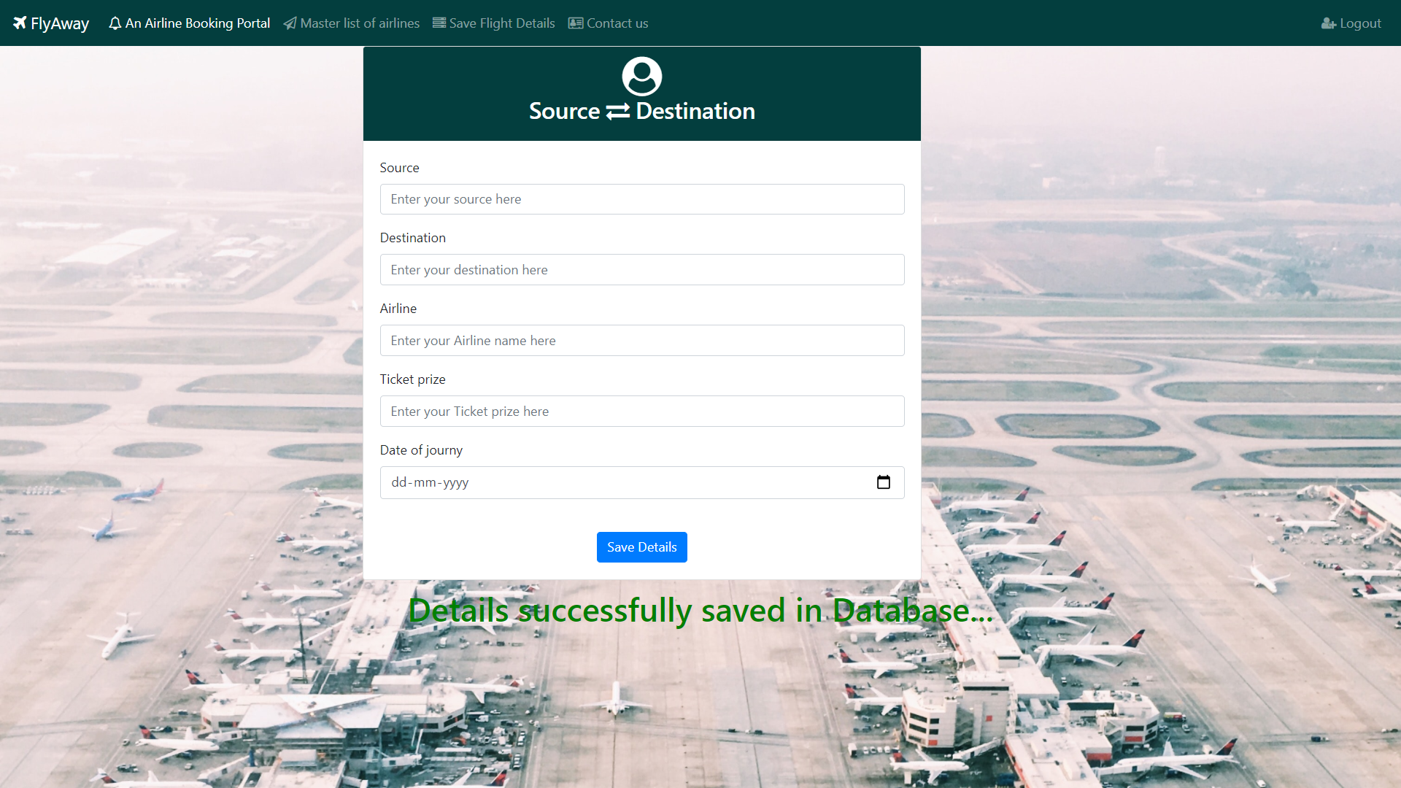
After saving (ADMIN)…

Slide 12
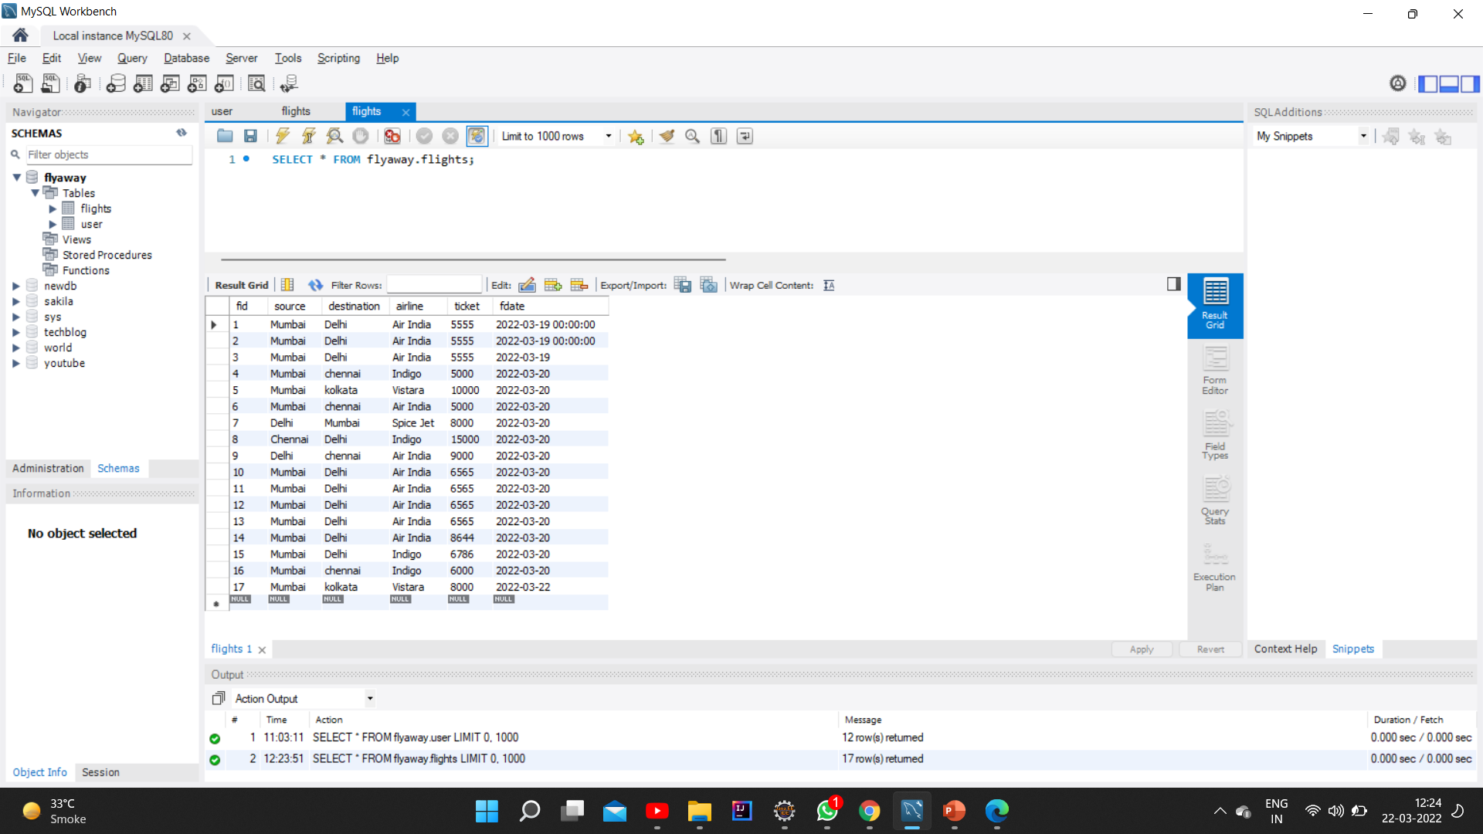
After saving DB status

Slide 13

User Login

Slide 14
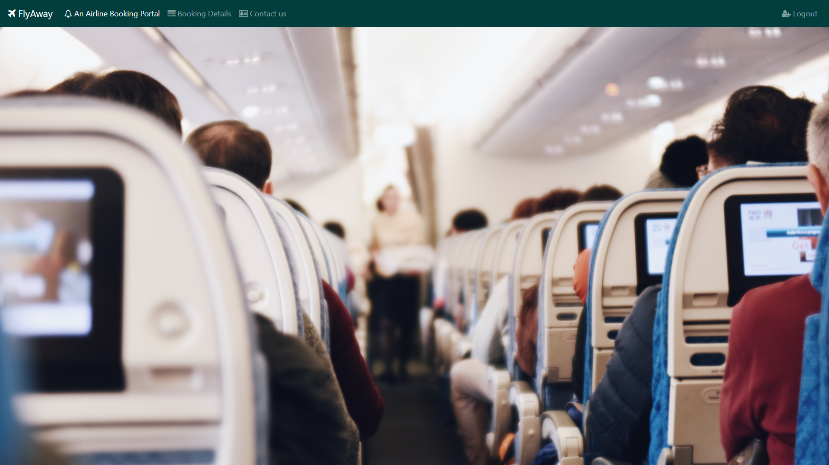
User workspace

Slide 15
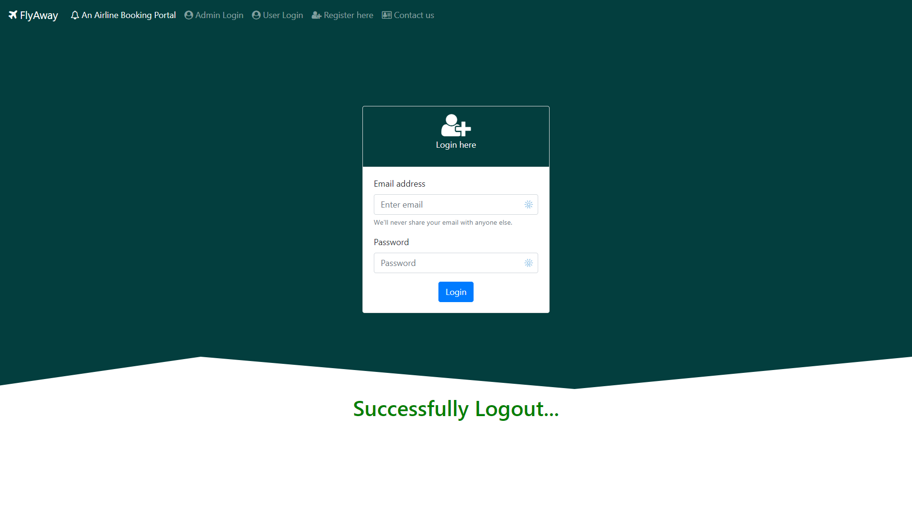
Logout module

Slide 16

Search Module

Slide 17
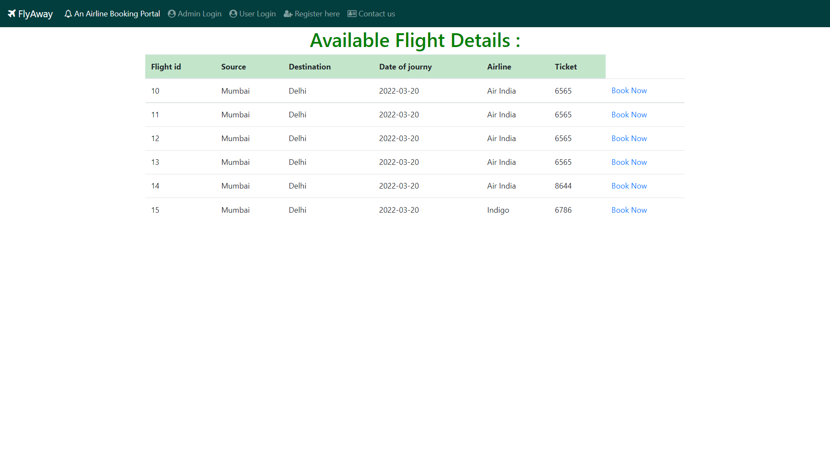
Available Flights Details
If I want to book this flight

Slide 18
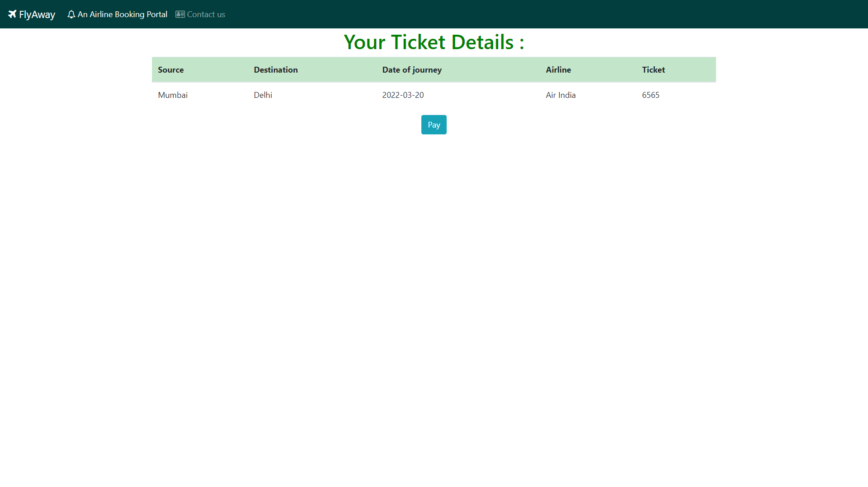
Your ticket Detail…
Click on pay if you want to conform the ticket

Slide 19
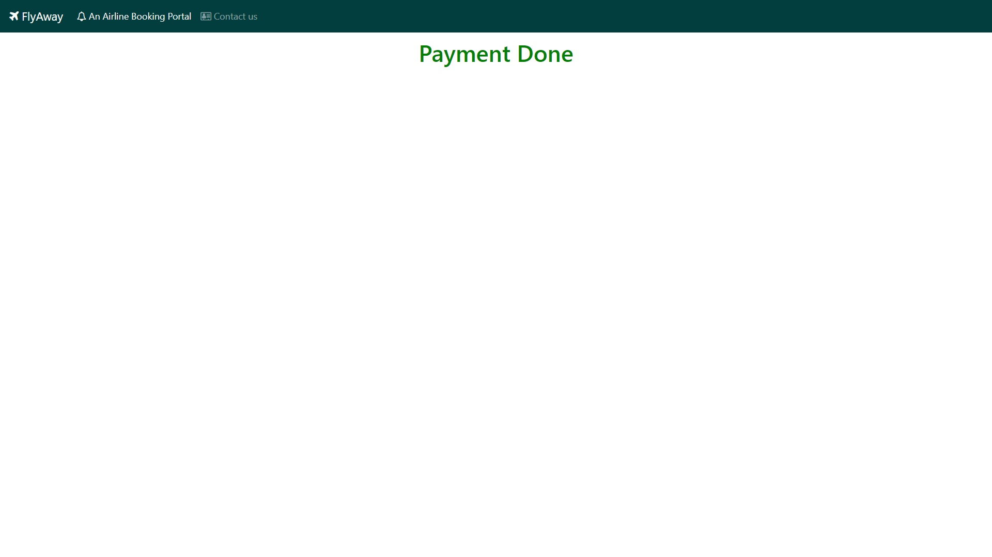
After Payment

Slide 20


